Slide 1
Introduction To Software Engineering.

Slide 2
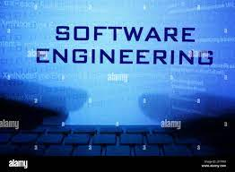
Software Engineering.
Bjarne Stroustrup, the creator of the C++ programming language,once said that "our civilization runs on software." This statement is impressively backed by reality, in which software controls a huge variety of devices, from cell phones and music players, to smart appliances such as microwave ovens and laundry machines, to personal computers that many people use at work and large mainframe computers that operate in governmental organizations

Slide 3
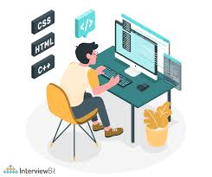
Using a basic definition, software means computer programs and their associated documentation. Computer programs, in turn, consist of algorithms (or procedures) applied to various types of data. Software engineering emerged in the late 1960s as a new engineering discipline concerned with all aspects pertaining to software production. It encompasses concepts, principles, theories, techniques and tools that can be used for developing high-quality professional software.

Slide 4
High-quality software is characterized by:
High dependability (including safety, security and reliability)
Efficiency
Usability
Accessibility
Maintainability
First introduced at the 1968 NATO Software Engineering Conference in Garmisch, Germany, software engineering emphasizes a systematic, disciplined approach to software development and evolution and typically applies to the construction of large software systems (or products) in which teams of numerous software engineers are involved.

Slide 5
Applications of software engineering
Software engineering applications are practically unlimited. In fact, software engineering has grown so fast in the last several decades that it has become tightly connected with all other areas of computer science (e.g., artificial intelligence, parallel processing, computer graphics, human-computer interaction, database management systems, and many others) as well as with some areas outside the traditional computer domain (such as cognitive sciences and visual arts).
Studying software engineering
Students who want to focus on software engineering are expected to gain and integrate knowledge from various subject areas including computer programming, data structures, algorithms, numerical methods, statistics, design patterns, human-computer interaction, computer graphics, information visualization, database systems, web development, software project management, and software engineering.

Slide 6
Challenges in software engineering
current challenges in software engineering research and development include:
Dealing with the increased complexity of software required in new applications
The diversity of software systems that need to communicate/operate with each other
The need to develop trustworthy software
Increased market demands for a quick turnaround from concept to deployment and operation
The quest for increased efficiency in component-based reuse and automatic code generation

Slide 7
Internship and employment opportunities in software engineering.
Software engineers are in high demand nationally and abroad. The list of companies hiring software engineers is practically endless. While most jobs are in industry, research labs also hire skilled software engineers, either for research in software engineering itself or for supporting software development in research environments. Furthermore, skilled software engineers are also hired by start-up companies, or are well prepared to start their own software development companies.
Notably, under the umbrella of software engineering several specialized professions exist besides software engineer itself, including computer programmer, analyst, designer, developer, tester, consultant and others.

Slide 8
What Tasks do Software Engineers do?Successful
software engineers use programming languages, platforms, and architectures to develop everything from computer games to network control systems. In addition to building their own systems, software engineers also test, improve, and maintain software built by other engineers.
￼Day-to-day tasks for a software engineer might include:Designing and maintaining software systems or applicationsEvaluating and testing new software programsOptimizing software for speed and scalabilityWriting and testing codeEnsuring platform compatibilityCreating and enforcing IT standards within an infrastructureMaintaining documentation of IT systemsReleasing software updatesCollaborating with development teams, senior systems architects, and data science professionalsConsulting with clients, engineers, security specialists, and other stakeholdersRecommending software upgrades for existing programs and systemsPresenting new features to stakeholders and internal customers

Slide 9

What Careers Are There in Software Engineering?
What Careers Are There in Software Engineering?￼Career opportunities in software engineering are driven by new technologies in automobiles, aviation, data management, telecommunications, factory control, robotics, defense, and security. Software engineers may develop computer games, business applications, operating systems, network control systems, and more. A bachelor's degree or higher is often required to work as a software engineer.Two common jobs within software engineering are applications developers and systems developers.Applications developers design computer applications, such as games, for consumers.

Slide 10
What Skills do Software Engineers Need?
Software developers design software to help solve problems faced by real people. This requires a combination of both technical and soft skills. A bachelor's degree in computer science, software engineering, or a related degree program is the most common entry-level requirement for software engineers.Generally speaking, most software engineers will need to have the following technical knowledge and skills:
Coding languages like Python,
Java,
C,
C++,
ScalaObject-oriented programmingDatabase architecture
Agile Scrum roject management
Operating systems
Cloud computing
Version control
Design testing and debugging

Slide 11
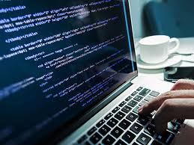
They may create custom software for a specific customer or commercial software to be sold to the general public. Some applications developers create databases or programs for use internally or online.
Thank you…

